Slide 1

EYAM – The Plague Village
Ring-a-Ring o'Rosies
A Pocket full of Posies
"A-tishoo! A-tishoo!"
We all fall Down!

Slide 2
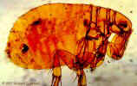
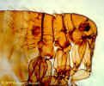
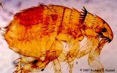
The Great Plague entered London in the 17th Century and came to a small village called Eyam by the most unfortunate of mishaps - carried by fleas festering in a box of cloth brought from the capital for the village tailor.

Slide 3
Once the Plague entered the village William Mompesson, the rector, with Thomas Stanley, persuaded the villagers to enter voluntary quarantine so that the Plague would not be spread to the surrounding villages.
They had to bury their own dead and worship outdoors to limit the spread of the disease.

Slide 4
People in the surrounding area sent provisions to the people of Eyam which were left on the village boundary. There was no contact at all with people from outside the village!
The death toll was terrible – in the 14 months from September 1665 to October 1666, 76 families were affected and 274 people died.

Slide 5
Some families were wiped out. Others left just a single survivor - like the Hancock family, at Riley Farm, where Elizabeth Hancock buried her husband and six children in just eight days.
The sufferings of the families - the Coopers, the Hadfields, the Syddals, the Thorpes, the Blackwells, the Talbots, the Mortens, the Kempes, the Merrills, are recorded on their houses around the village.
When the Plague finally loosed its terrible grip on the village 80% of the villagers had died!

Slide 6
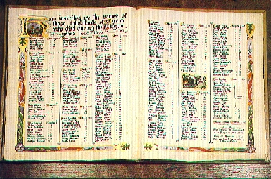
"Here inscribed are the names..."

Slide 7
What next?
Your Task
Investigating at least two statistical variables from the source provided.
Make a written report to display all your results and findings.

Slide 8
Sampling, Processing and Representing data
Organising Data:
Tally Charts
Frequency Tables
Calculation of Summary Statistics:
Measures of Central Tendency
– Mean, Median and Mode
Measures of Spread
– Calculate ranges, IQR and Standard Deviations

Slide 9
Sampling, Processing and Representing
Representative Diagrams:
Bar Charts
Stem and leaf diagrams
Histograms

Slide 10
Written Report :
Interpret and Discuss Results
Interpret results and make any relevant comparisons
Write a conclusion.
Comment on what you did well and what else you
could have done.
Evaluate your overall strategy.
Discuss the limitations of this project.
Write about any practical problems you encountered.

Slide 11
Reflection
Would you have stayed in the village if you had the choice?
Why do you think the actions of the villagers of Eyam might be important to us today?

